Slide 1



IOT-Integrated Wearable Stress Monitoring System
ANNAPOORANA ENGINEERING COLLEGE (Autonomous)
Guide Name
Presented by
Mrs.R.Umamageswari, M.E
ASP/CSE
K.Abinaya (610221104001)
M.Rubala (610221104036)
A.Premsundar (610221104315)

Slide 2
ABSTRACT
Stress is a significant factor affecting human health, necessitating real-time monitoring for early detection and intervention. This project presents an IoT-integrated wearable stress monitoring system that utilizes multiple sensors to track physiological parameters.
A Galvanic Skin Response (GSR) sensor monitors stress levels, while a heart rate sensor tracks the user’s heart rate. The system is controlled by an ESP32 microcontroller, which processes sensor data and manages communication.
In case of abnormal readings, a GSM module sends SMS notifications to registered mobile numbers, and a buzzer provides an immediate alert to the user.

Slide 3
EXISTING SYSTEM
The existing system for stress monitoring primarily relies on wearable devices like smartwatches, which measure physiological parameters such as heart rate variability (HRV), and physical activity.
While these devices provide basic insights into stress levels, they lack deep integration with cloud-based IoT platforms and do not offer continuous, real-time stress monitoring.
Additionally, mobile health apps and medical methods, such as self-reported questionnaires (e.g., Perceived Stress Scale) and clinical tests (e.g., cortisol measurement), are often used for assessing stress but are either subjective or time-consuming, providing limited or non-continuous data.

Slide 4
PROBLEM STATEMENT
In today's fast-paced and demanding environment, chronic stress has become a prevalent health issue, contributing to a range of physical and mental health problems such as hypertension, heart disease, depression, and anxiety disorders.
Despite the growing awareness of stress-related health risks, early detection and continuous monitoring of stress levels remain challenging due to the lack of accessible, real-time, and non-invasive monitoring solutions.
Traditional methods for stress assessment, such as self-reporting questionnaires or occasional clinical evaluations, are often subjective, infrequent, and unable to capture dynamic changes in an individual’s stress levels.

Slide 5
PROPOSED SYSTEM
The system uses a Galvanic Skin Response (GSR) sensor to measure skin conductivity, detecting stress levels in real-time.
A heart rate sensor continuously tracks the user’s pulse to identify abnormal variations linked to stress or health conditions.
The ESP32 microcontroller efficiently collects and processes data from sensors, ensuring seamless operation and real-time analysis.
A GSM module sends SMS alerts to predefined contacts in case of critical stress or heart rate levels, while a buzzer provides an immediate audio alert.
The system uses GPS to track the user’s live location and IoT for transmitting alerts to authorized personnel wirelessly, ensuring timely intervention

Slide 6
ADVANTAGES
Real-Time Stress and Health Monitoring.
Automated Alerts and Location Tracking.

Slide 7
SOFTWARE REQUIREMENTS
ARDUINO IDE
EMBEDDED C
BLYNK IOT
HARDWARE REQUIREMENTS
TRANSFORMER
POWER SUPPLY UNIT
ESP32 MICROCONTROLLER
GSR SENSOR
BUZZER
GPS
GSM
HEART BEAT SENSOR

Slide 8
BLOCK DIAGRAM
TRANSFORMER
RECTIFIER
CAPACITOR
VOLTAGE REGULATOR IC 7812
VOLTAGE REGULATOR IC7805
GSR SENSOR
ADC
ESP32
CONTROLLER
BUZZER
HEART RATE SENSOR
ADC
SPI
IOT
GSM
GPS

Slide 9
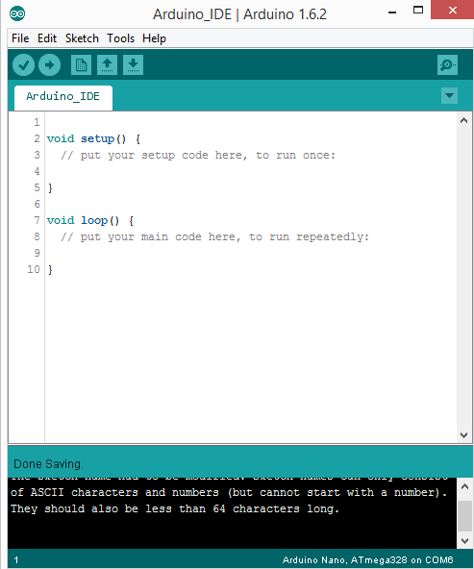
ARDUINO IDE

Slide 10
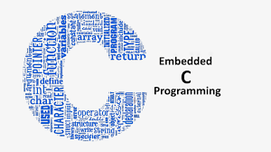
EMBEDDED C
Embedded C language is used to develop microcontroller-based applications.
Embedded C is an extension to the C programming language including different features such as addressing I/O, fixed-point arithmetic, multiple-memory addressing, etc. In embedded C language, specific compilers are used.

Slide 11
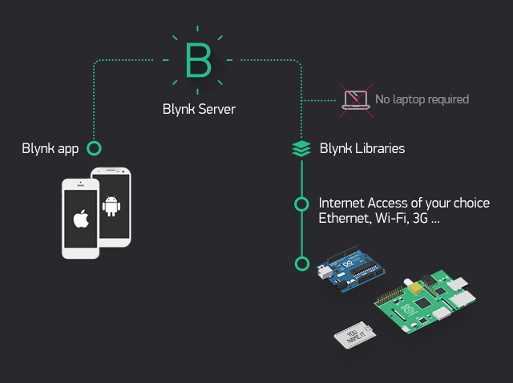
BLYNK APP
Blynk was designed for the Internet of Things. It can control hardware remotely, it can display sensor data, it can store data, visualize it and do many other cool things.
Features
Similar API & UI for all supported hardware & devices
Connection to the cloud using:
WiFi
Bluetooth and BLE
Ethernet
USB (Serial)
GSM
Set of easy-to-use Widgets
Direct pin manipulation with no code writing

Slide 12
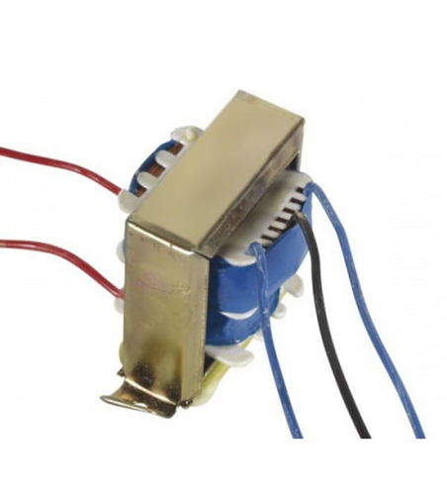
TRANSFORMER
Input Voltage: 230V AC
Output Voltage: 12V, 12V or0V
Output Current: 5 Amp
Mounting: Vertical mount type
Winding: Copper

Slide 13
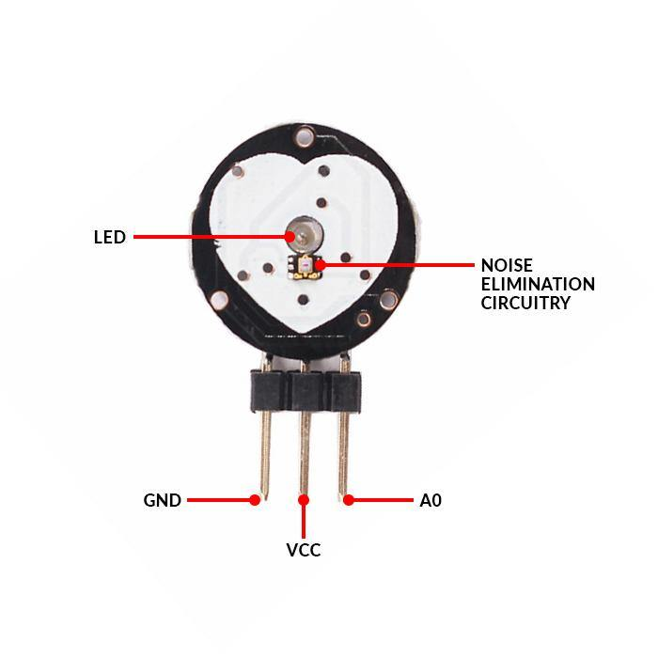
PULSE SENSOR
Its detector that monitors this volume change is called a pulse sensor.
The range of output from the Pulse Sensor running at 3.3V is only 0 to 675.

Slide 14
GSR SENSOR
The GSR sensor measures the varying levels of the skin conducting the electric current. Higher levels of perspiration on the skin lead to a greater conductance of electrical currents.
A higher level of conductivity of the skin after an event can therefore be interpreted as either positive or negative emotional arousal.
GSR value is measured by placing electrodes appropriately at the fingertips usually index and middle fingers.
The fingertips of these fingers have less skin thickness and hair presence. Hence it provides better results compare to other fingers.
Technical specifications of Grove GSR sensors are as follows. • Operating voltage : 3.3V/5V • Sensitivity : Adjustable via a potentiometer • Input signal : Resistance, not conductivity • Output signal : Voltage, analog reading

Slide 15
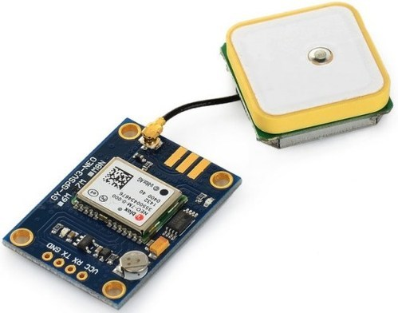
GPS MODULE
The Global Positioning System (GPS) is a satellite-based navigation system made up of at least 24 satellites
It calculates the real-time position of a device using atomic clocks and orbital satellites.
The time information is placed in the codes broadcast by the satellite so that a receiver can continuously determine the time the signal was broadcast.

Slide 16
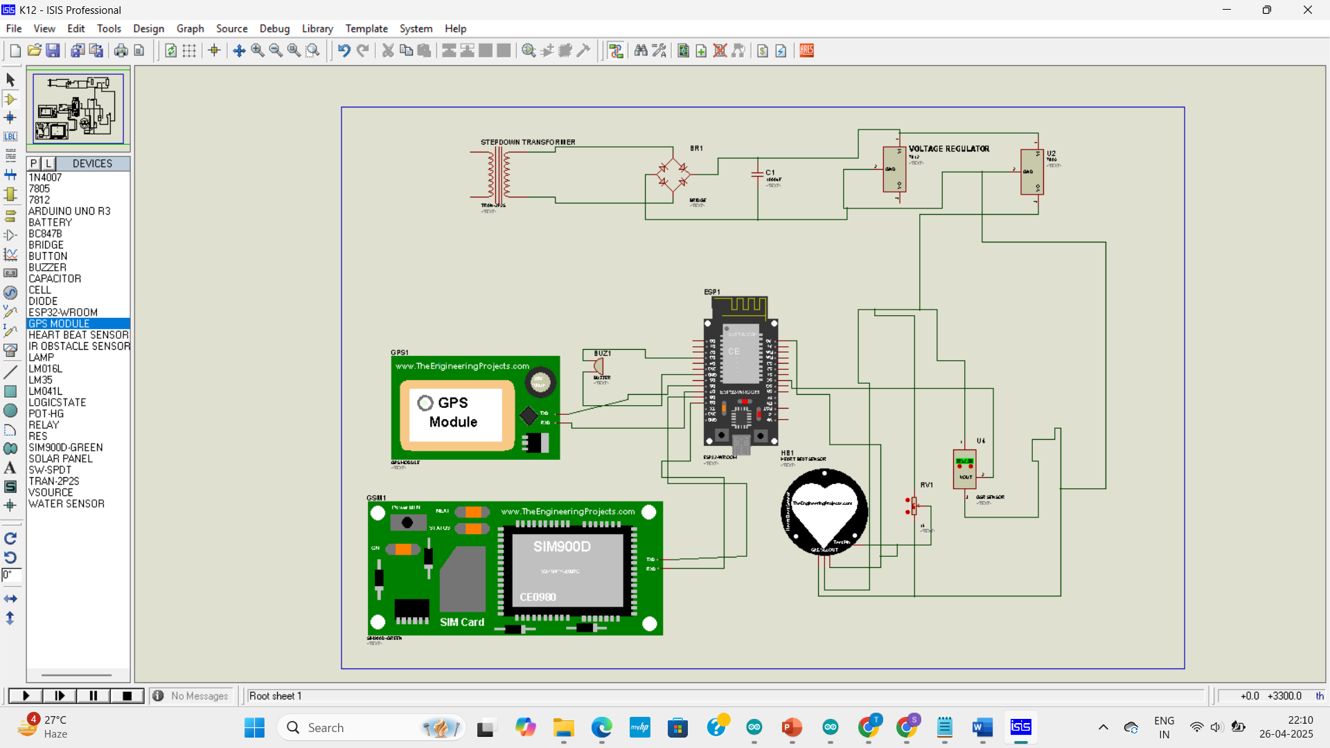
SIMULATION DESIGN

Slide 17

HOME PAGE

Slide 18
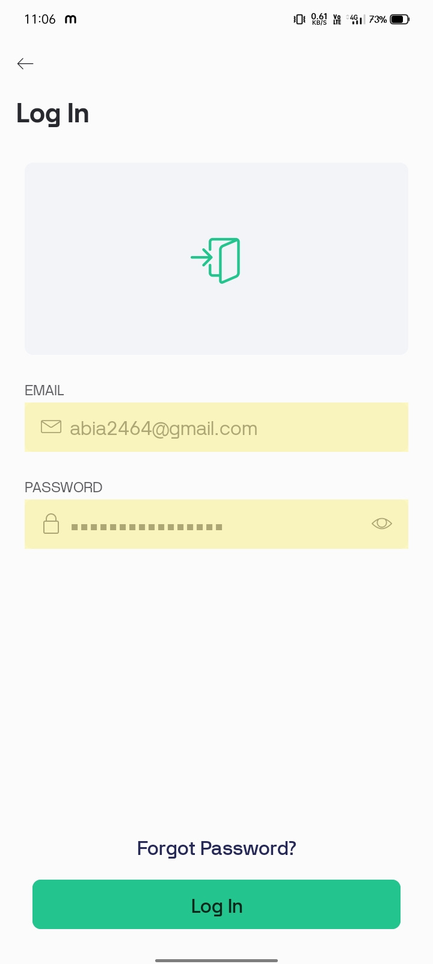
LOGIN PAGE

Slide 19
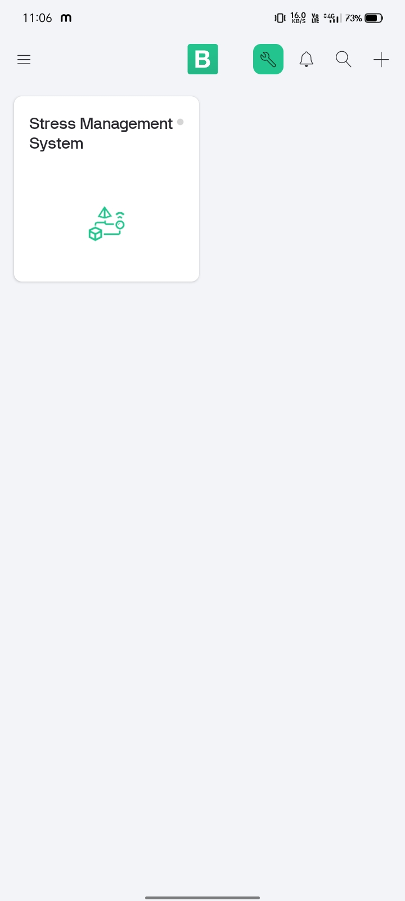
INDEX PAGE

Slide 20
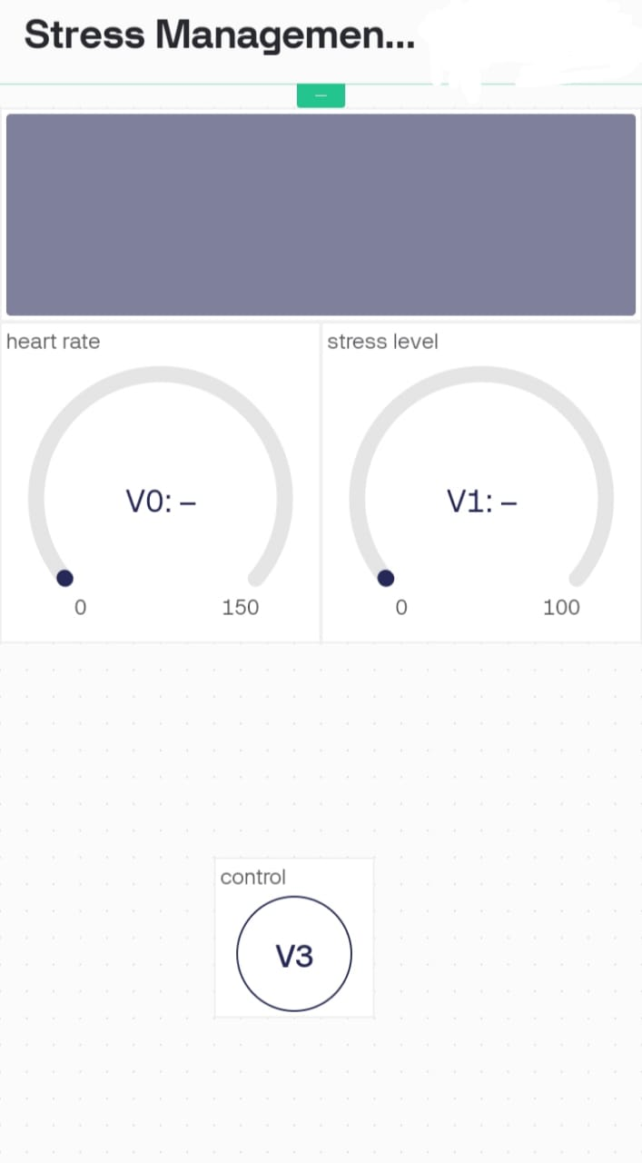
INITIAL VALUES

Slide 21
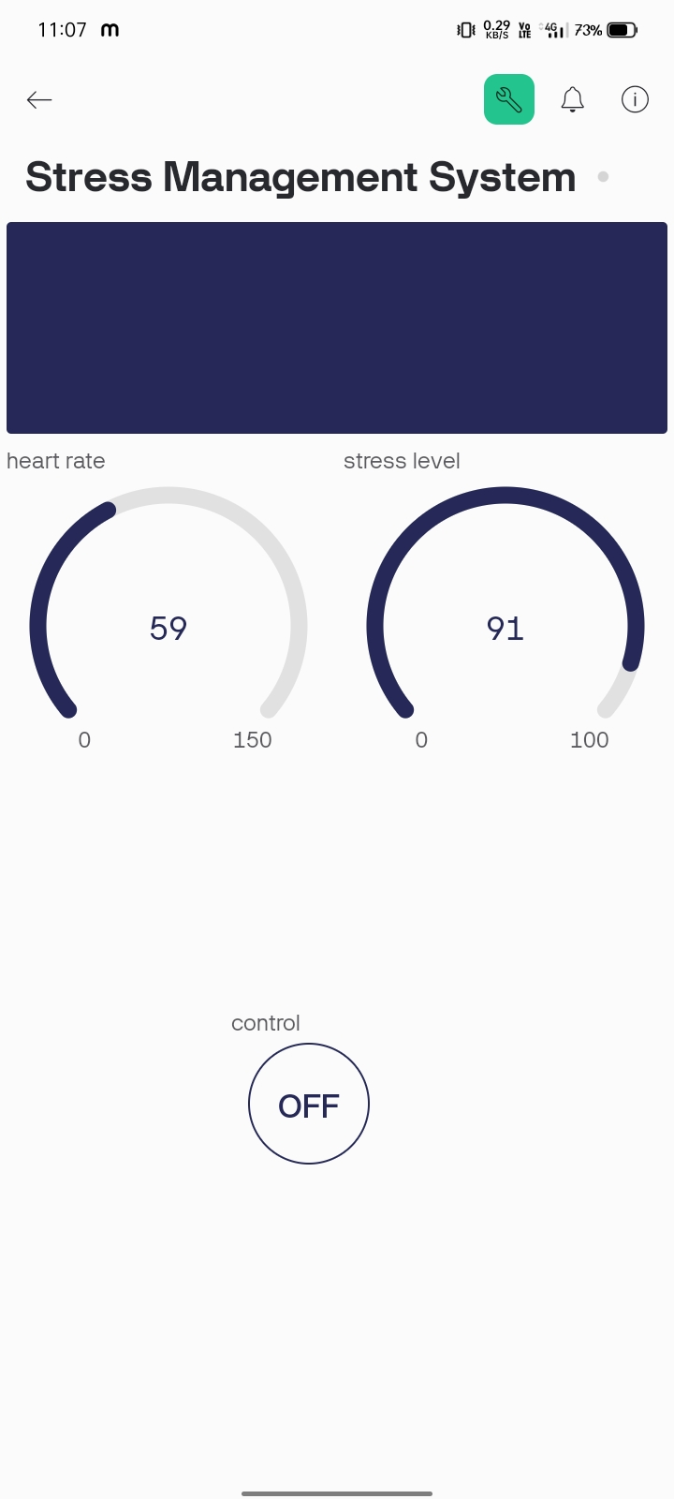
REALTIME VALUES

Slide 22
CONCLUSION
The IoT-Integrated Wearable Stress Monitoring System effectively utilizes multiple sensors, including the GSR sensor for stress level monitoring and the heart rate sensor for tracking heart rate, ensuring real-time health monitoring.
The ESP32 controller efficiently manages sensor operations, while the GSM module enables mobile SMS alerts and the buzzer provides immediate audible warnings, enhancing user safety.
GPS integration allows real-time location tracking, ensuring rapid response in emergencies, while IoT connectivity facilitates seamless wireless notifications to authorized personnel for prompt action.
This system offers a comprehensive, real-time health monitoring and alert mechanism, making it a reliable solution for stress detection and emergency response through wearable technology.

Slide 23
REFERENCES
T. Vos et al., "Global burden of 369 diseases and injuries in 204 countries and territories 1990–2019: a systematic analysis for the Global Burden of Disease Study 2019", The lancet, vol. 396, no. 10258, pp. 1204-1222, 2020.
S. J. Lamontagne, E. D. Ballard and C. A. Zarate, "Effects of stress on endophenotypes of suicide across species: A role for ketamine in risk mitigation", Neurobiology of stress, vol. 18, pp. 100450, 2022.
J. Medikonda, "A clinical and technical methodological review on stress detection and sleep quality prediction in an academic environment", Computer methods and programs in biomedicine, vol. 235, pp. 107521, 2023.
A. J. Steckl and P. Ray, "Stress biomarkers in biological fluids and their point-of-use detection", ACS sensors, vol. 3, no. 10, pp. 2025-2044, 2018.

Slide 24
THANK YOU !!

